Slide 1


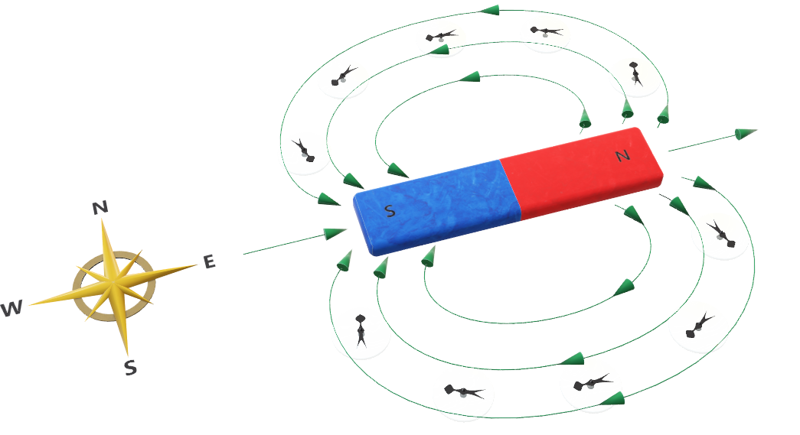
Duration: 60 min
High School
Grade: 11
CCSS, NGSS
Magnetism:
Magnetic Fields
Author: Michael Carter
Click on the model to interact

Slide 2

Lesson overview
Magnets are common items in our daily lives. Playing around with some magnets, we can see some basic features:
Magnets exert force on each other, as well as on certain metals.
This force is strongest when they are touching, but also acts at a distance.
Magnets can either attract or repel each other, depending on how they are held.
Learning objectives
Know how to determine the direction of a permanent magnetic field.
Know that a current-carrying wire creates a magnetic field.
Know how to determine the direction of the magnetic field produced by a current-carrying wire.
Keywords
Magnetic Domains, Magnetic Poles, Magnetism, Right-Hand Rule

Slide 3
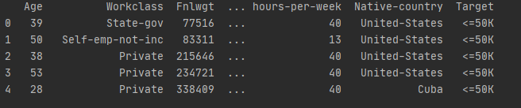
Pearson’s Correlation

Slide 4
Texbook correlations
Hewitt, P.G. (2009) Conceptual Physics. Upper Saddle River, NJ: Pearson Education. Unit V – Electricity and Magnetism, 36 – Magnetism, 720-732.
Serway, R.A., & Faughn, J.S. (2009) Holt Physics. Austin, TX: Holt, Rinehart and Winston. Chapter 19 – Magnetism, Section 1 – Magnets and Magnetic Fields, 676-682.
Walter, J.S. (2014) Pearson Physics. Upper Saddle River, NJ: Pearson Education. Chapter 22 – Magnetism and Magnetic Fields, 782-815.
Nirenberg, I. (2016) CK-12 Physics - Intermediate. Palo Alto, CA: CK-12 Foundation. 18.1 Magnetic Fields

Slide 5

ENGAGE
10
min
Pair students and have them study the 3D model “Coil of Wire and Moving Magnet” in the Lifeliqe Physics library. Then, have them discuss and share their answers to the questions:
What is causing the needle to move?
Why does it move back and forth?
Post and/or pose the essential questions of the lesson:
How do you determine the direction of a permanent magnetic field?
How does a current-carrying wire create a magnetic field?
How do you determine the direction of the magnetic field produced by a current- carrying wire?
EXPLORE
Click on the model to interact
20
min
Have students read “Magnetic Fields.”
www.ck12.org/section/Magnetic-Fields-Physics-Intermediate/

Slide 6
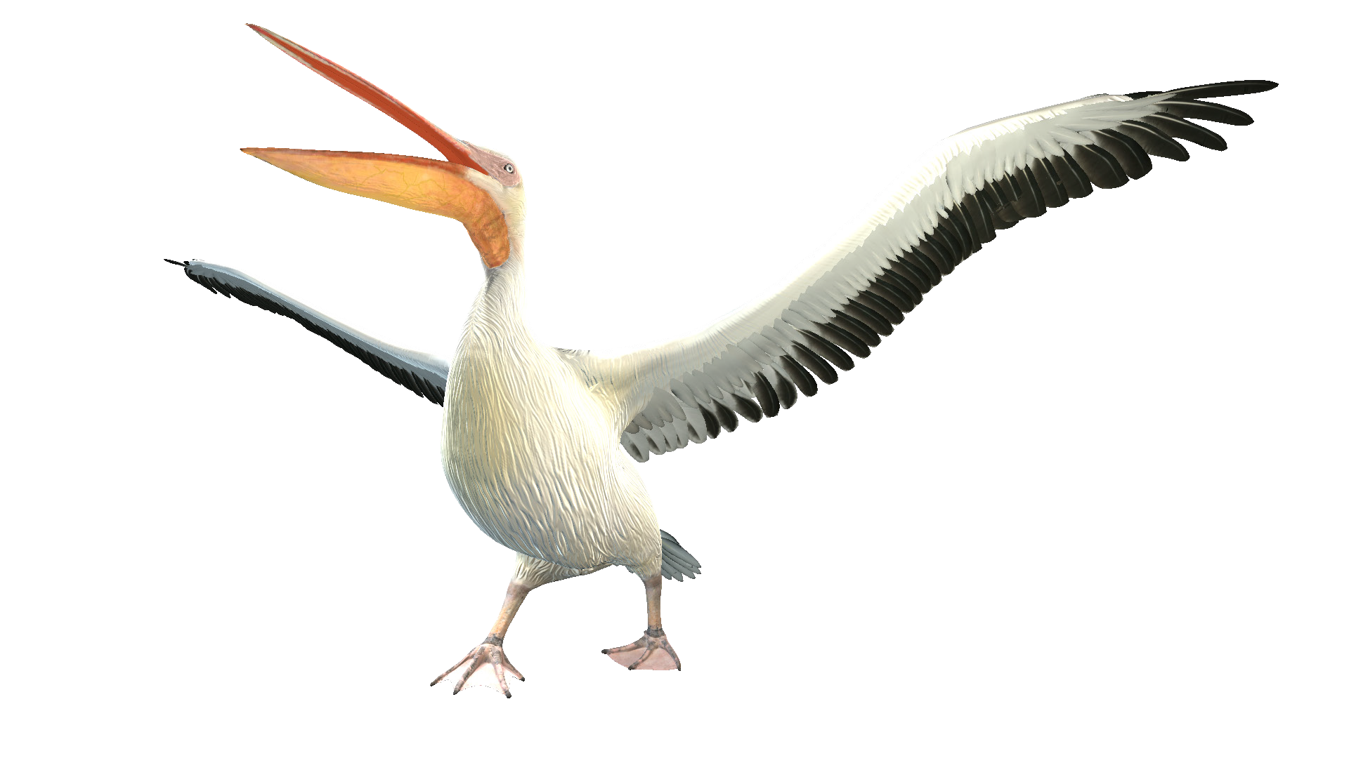
EXPLAIN
10
min
Click to open in Lifeliqe
Pair students and have them study the 3D model “Greater White Pelican” in the Lifeliqe
Animal Biology library. Then, have them discuss and share their answers to the questions:
What role do magnetic fields play in this bird’s annual migration?
How does it know which way it’s going?

Slide 7
EXTEND / ELABORATE
10
min
Have students take what they have learned and see it in authentic contexts.
Show, or have students view, “10 AWESOME MAGNET TRICKS!” www.youtube.com/watch?v=h5oXWtSMHzw
EVALUATE
10
min
“Magnetic Fields”
www.ck12.org/section/Magnetic-Fields/
Select content for this lesson plan was derived from Nirenberg, I. (2016) CK-12 Physics - Intermediate. Palo Alto, CA:
CK-12 Foundation. Except as otherwise noted, all cK-12 content (including cK-12 curriculum material) is made available to users in accordance with the Creative Commons Attribution-Non-Commercial 3.0 Unported (CC BY-NV 3.0)
License (http://creativecommons.org/licenses/by-nc/3.0/). http://www.ck12.org/saythanks.

Slide 8

Thanks for using Lifeliqe's lesson plan!
Excite your students in learning science with 1,000+ more 3D models and lesson plans at online.lifeliqe.com

